Slide 1

Scikit-mobility Human mobility analysis and simulation with Python
Realized by : Hamza Chokri

Slide 2
Outline
🟠Introduction
🟣Scikit-mobility
🔴The Human Mobility data landscape
🔵Human Mobility Measures
🟢Privacy risk assessment for mobility data
🟤Collective models
Notes:
Notre plan sera repartir comme suit : commançant par

Slide 3
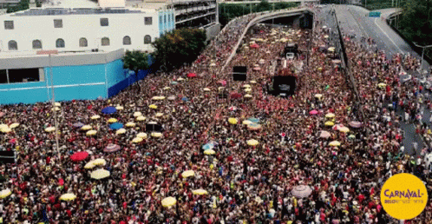

Introduction
The last decade has witnessed the emergence of massive mobility data sets .
social media platforms
Call detail records
Tracks generated by GPS devices
Computational epidemiology
Various applications of mobility analysis
Urban planning
Transportation engineering

Slide 4
“Human mobility is the study that describes how humans move within a network or system”

Slide 5
Scikit-mobility
Python library that has the ambition of providing an environment to reproduce existing research, analyze mobility data, and simulate human mobility habits.
Human mobility analysis
scikit-mobility provides the user with many functionalities :
Visualizing trajectories
Generating synthetic data
Analyzing statistical patterns
Assessing the privacy risk related to the analysis of mobility data sets

Slide 6
scikit-mobility modules
load and represent mobility data, both at the individual and the collective level,
By using two data structures (TrajDataFrame and FlowDataFrame) based on the standard python libraries (numpy , pandas , geopandas , folium , matplotlib ) .
Clean and pre-process mobility data using : trajectory clustering, compression, segmentation, and filtering .
Analyze mobility data by using the main measures characterizing mobility patterns (individual or collective ) :
🟤 Location frequencies
🟤 Waiting times
🟤 Origin-destination matrices
Estimate the privacy risk associated with the analysis of a given mobility dataset .

Slide 7
scikit-mobility modules
scikit-mobility has been conceived for human movement analysis and the privacy module makes sense for human mobility data only, most features can be applied to other types of mobility (e.g., boats, animal movements, boat trips).
Not only for Human mobility analysis
Applications
🔵 Car Crash prediction
how to exploit human mobility analysis to forecast whether a vehicle will crash
🔵 Migration Flow prediction
how to predict the flows of people between locations on a city/region/country

Slide 8
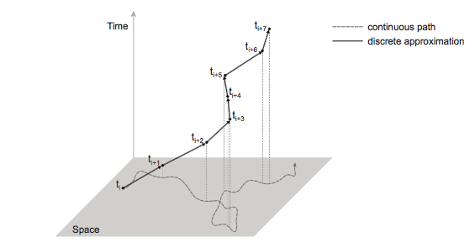
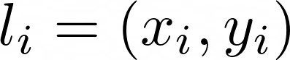
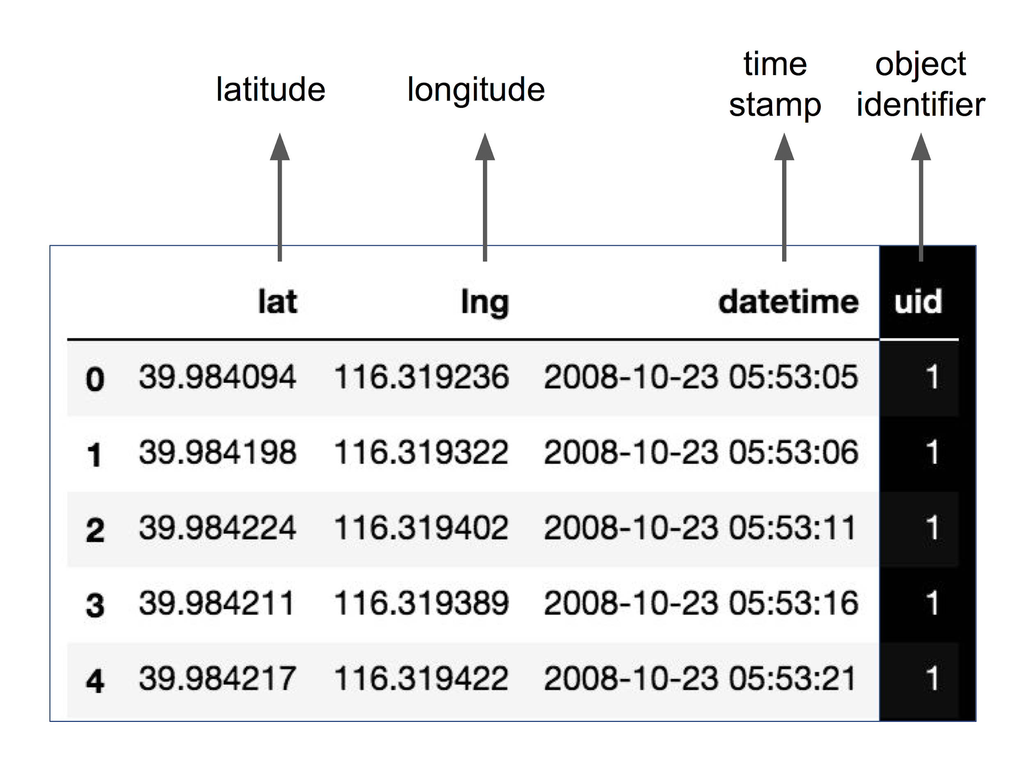
Representing mobility data
Trajectory. The trajectory of an object u is a temporally ordered sequence of tuples
where is a location, x_{i} and y_{i} are the coordinates of the location, and t_{i} is the corresponding timestamp, with t_{i}< t_{j} if i < j.
EPSG:4326 - WGS 84, latitude/longitude coordinate system
Represented by : TrajDataFrame data structure

Slide 9
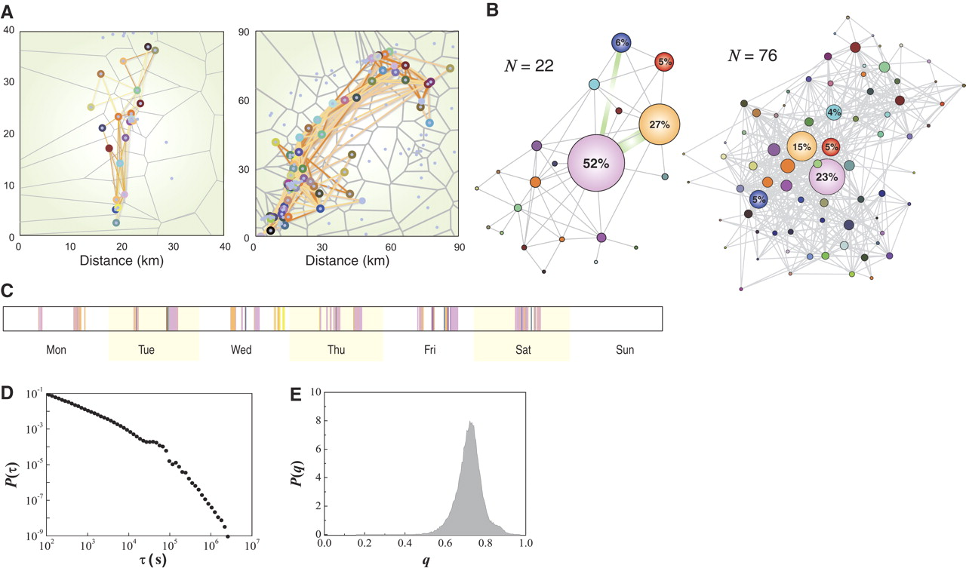
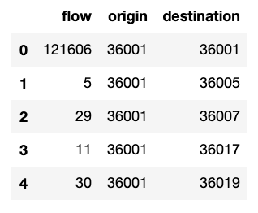
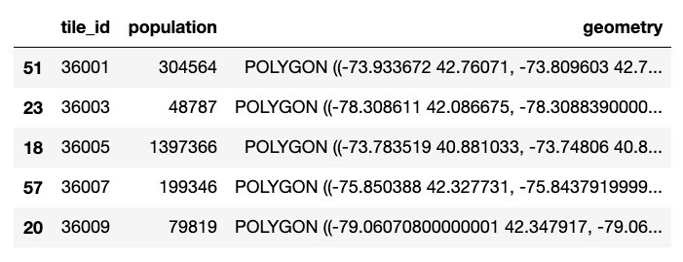
Flows
Flows. An Origin-Destination matrix T is a n×m matrix where:
n is the number of distinct “origin” locations
m is the number of distinct “destination” locations
T_{ij} is the number of objects traveling from i to j.

Slide 10
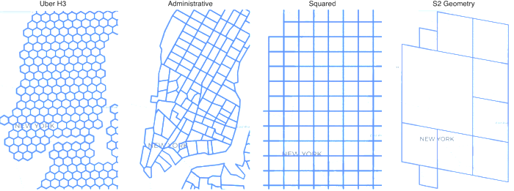
Flows
In mobility tasks, the territory is often discretized by mapping the coordinates to a spatial tessellation
Geometric shapes (e.g., squares, hexagons), called tiles, with no overlaps and no gaps.

Slide 11
Lab 1 : Data Structure in Scikit-mobility | Plotting trajectories and flows | Data pre-processing.

Slide 12
The Human Mobility data landscape

Slide 13


Call Detail Records (CDRs)
A call detail record (CDR) is a data record produced by a telephone exchange or other telecommunications equipment that documents the details of a telephone call or other telecommunications transactions
Produced by a phone carrier to store details of calls passing through a device
They contain various attributes of the call:
timestamp | source | destination | tower | duration
10/04/2008 10:12:00 | A8563XY | C1123YT | 36256 | 10:32
10/04/2008 10:12:32 | B6766CS | H2223IU | 43860 | 03:07
... | ... | ... | ... | ...

Slide 14

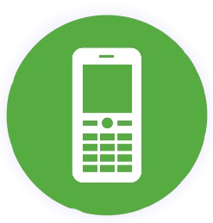
Call Detail Records (CDRs)
Location history
b
a
b
c
e
L=
c
a
e
d
Inferring mobility trajectories from CDRs
Notes:
PROs
mobile phones are ubiquitous
large (huge) sample size
rich and multidimensional (social, mobile, time, demographics)
CONs
not publicly available
position is partially detected (only when calls are made)
position is known at tower level only (resolution is variable from m to km)
ping-pong effect can create noise

Slide 15
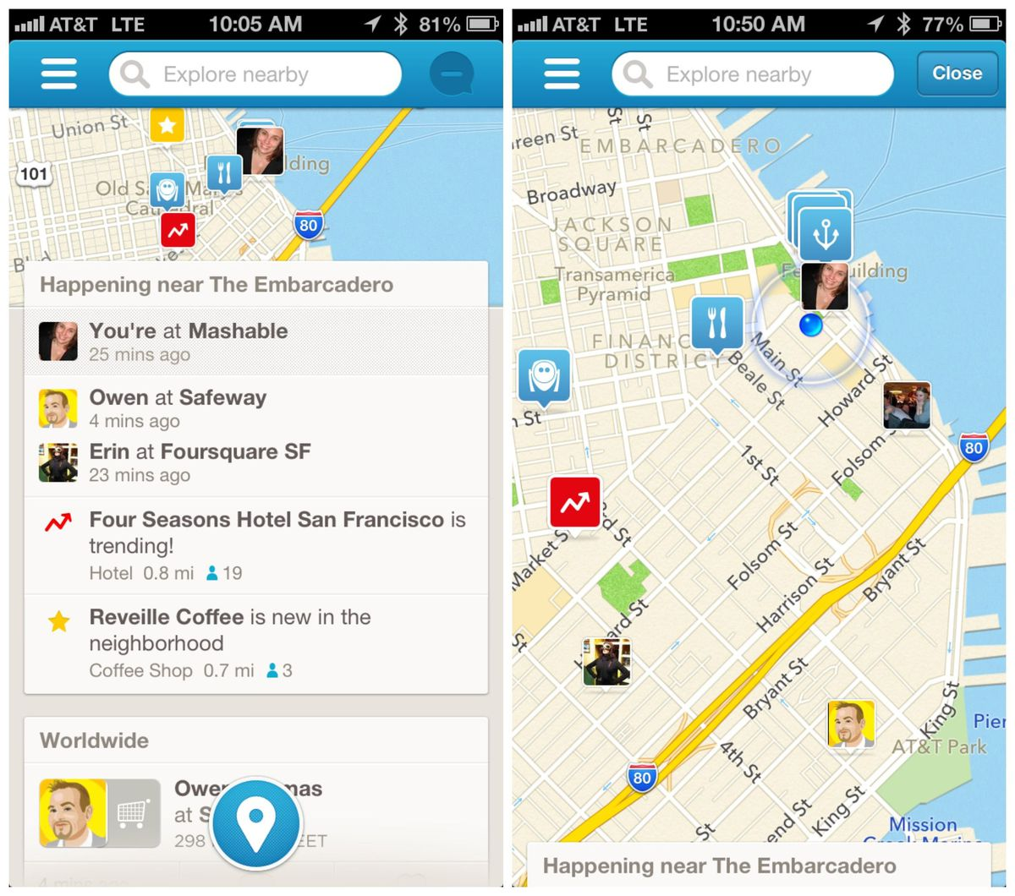
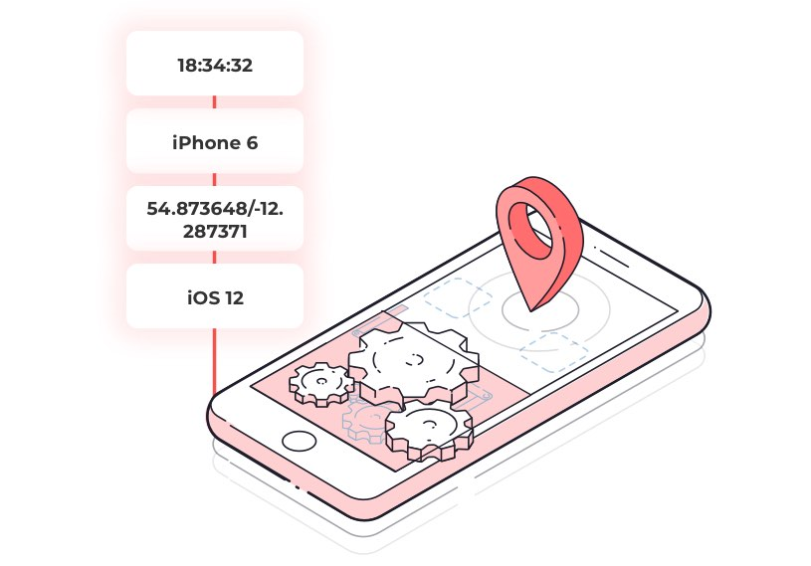
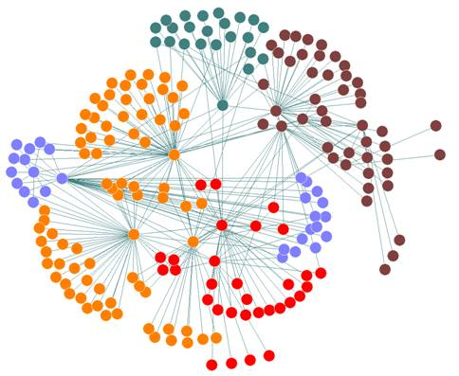
Location Based Social Networks (LBSN)
Social Network + Location Data
A new social structure made up of individuals connected by the interdependency derived from their locations in the physical world as well as their location-tagged media content.
Notes:
PROs
often publicly available
objective location and semantic information (e.g., restaurant, mall, etc.)
CONs
movement is partially detected (only when checkins are made)
data sparsity (more sparse than CDRs)
position is known at location level only
self-selection bias

Slide 16
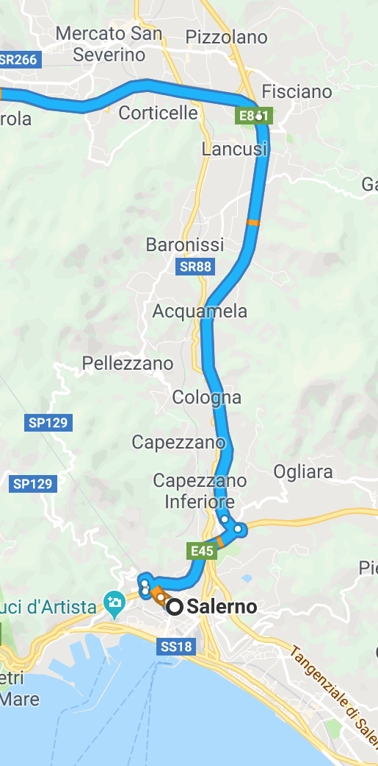
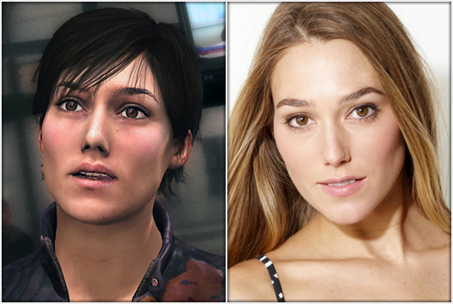
GPS data
Produced by GPS devices embedded in smartphones, private vehicles, boats, etc.
CDR
GPS
Notes:
PROs
trajectory at high spatial and temporal resolution
track the full trajectory (e.g., all cars movements)
CONs
no objective definition of location (preprocessing is needed)
errors when signal is noisy
Preprocessing on GPS data
Some common steps to apply on GPS data:
location detection group points into one meaningful location
trajectory segmentation split a trajectory in sub-trajectories
Stay Point detection algorithm
The points are scanned in temporal order, then if the following condition holds:
If ( di+1 ,di) <= Vitesse * t(i+1,i)
the points belong to the same stay point

Slide 17

Target
Understanding individual human mobility patterns .
Human mobility prediction based on individual and collective geographical preferences.
Friendship and mobility: user movement in location-based social networks.
Under the social microscope: characterizing human mobility

Slide 18

Human Mobility Measures
Individual measures: features related to the mobility patterns of a single individual
Collective measures: mobility patterns of an entire population of individuals
Jump length (or traveling distance)
The distance between two consecutive locations visited by an individual
Radius of gyration
The characteristic distance traveled by an individual

Slide 19
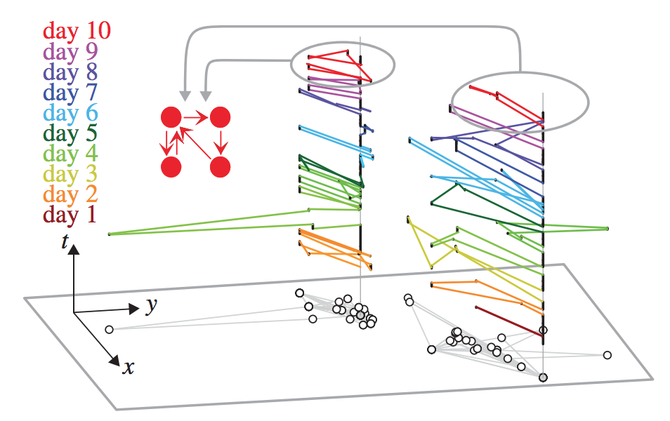
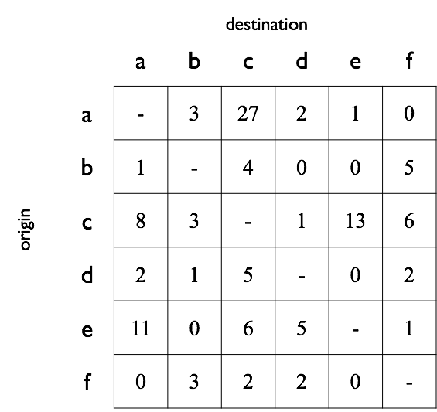
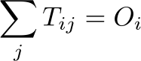
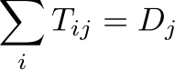
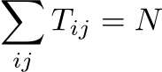
Daily Motif: a frequent network describing the daily movements of an individual
OD matrix
Total out-flow from i
Total in-flow to j
Schneider et al., Unravelling individual daily mobility motifs, Journal of the Royal Society Interface, 2013.
Total flow
(self-loops are usually not considered)

Slide 20

Privacy risk assessment for mobility data
What’s the meaning of privacy?
Privacy has many connotations
A series of principles Right to be let alone, to limit access to information etc.
Data privacy Regulated by national and international laws. Protect an individual's privacy and their personally identifiable information

Slide 21
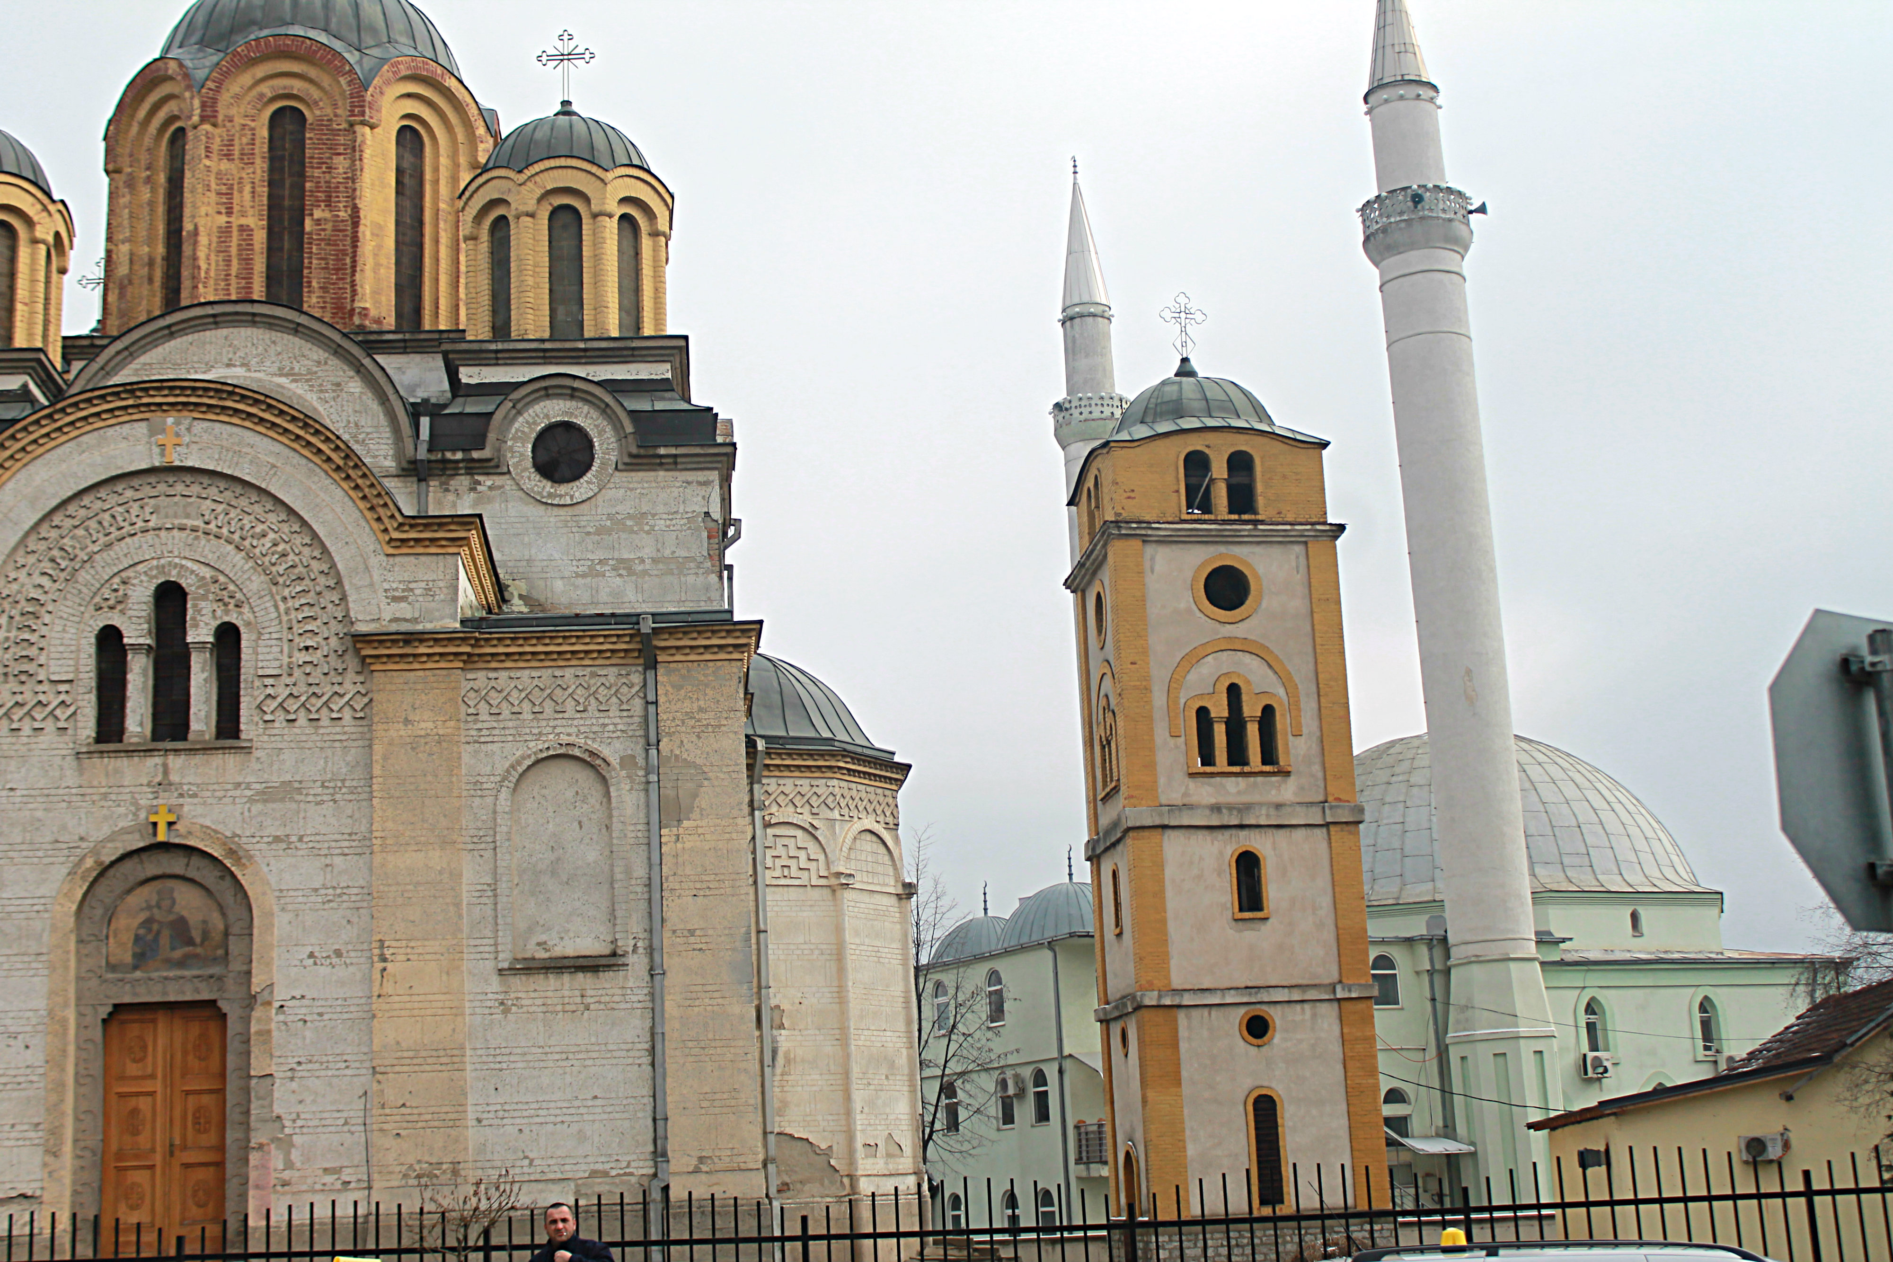
Why privacy for mobility data is a concern?
Mobility is a sensitive type of information Depending on the location visited, one could infer religious preferences, daily habits, health problems.
Mobility data is abundant and readily available Location based services, social media access etc.

Slide 22
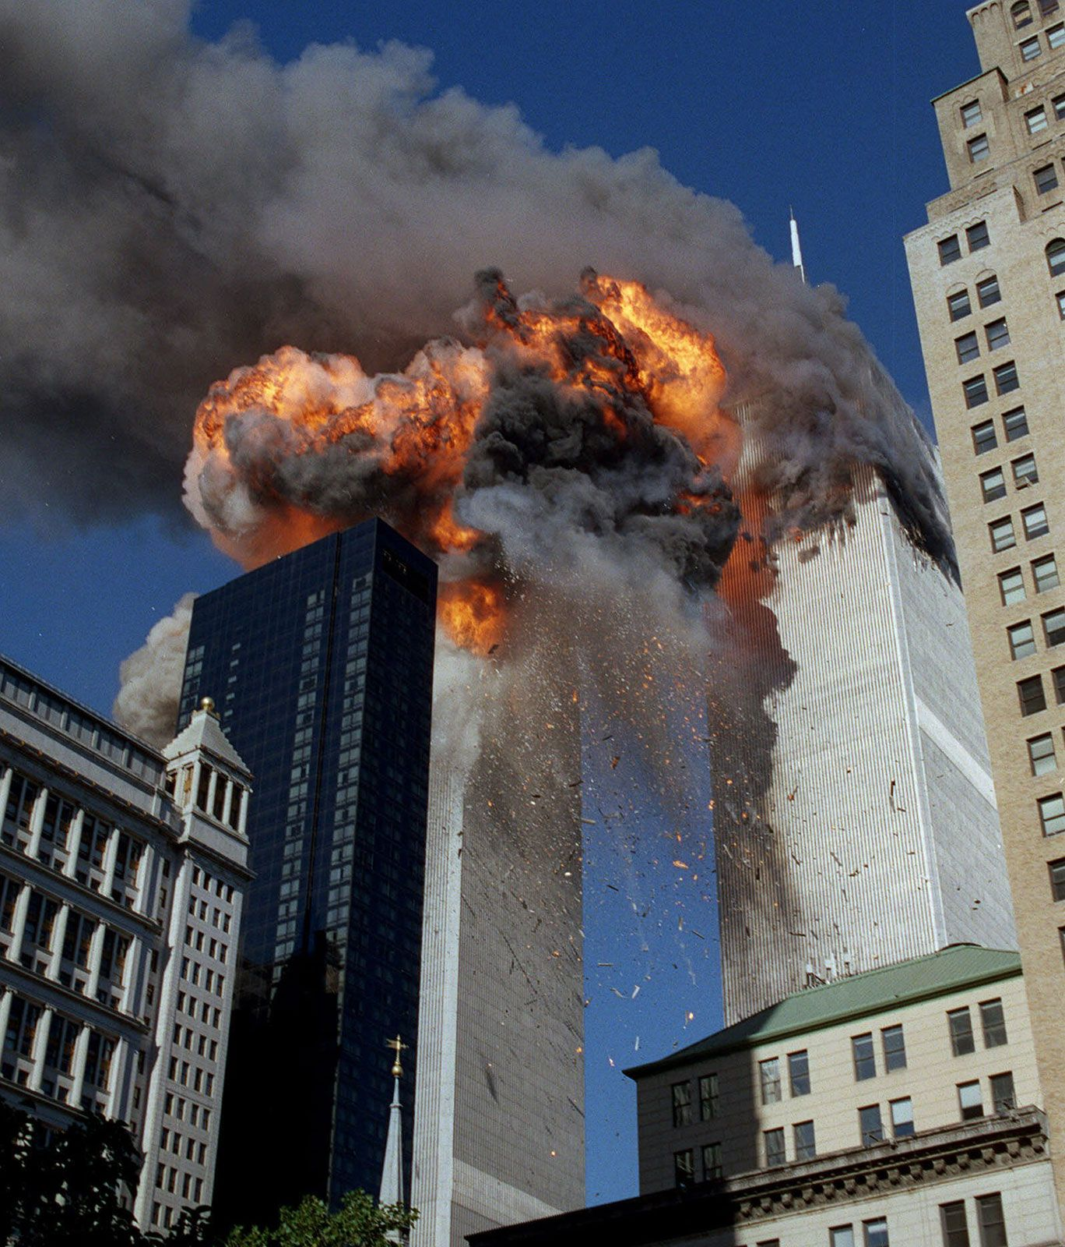
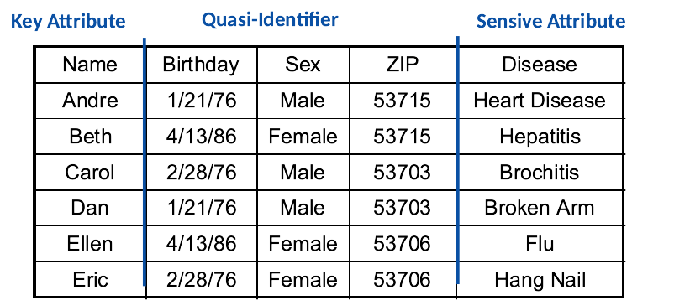
K-anonymity
⚫ Hide individuals amongst k-1 others
🟢 Generalization 🟢 Suppression
⚫ Privacy vs Utility Tradeoff
⚫ NP-Hard
⚫ Vulnerabilities: l-diversity and t-closeness

Slide 23

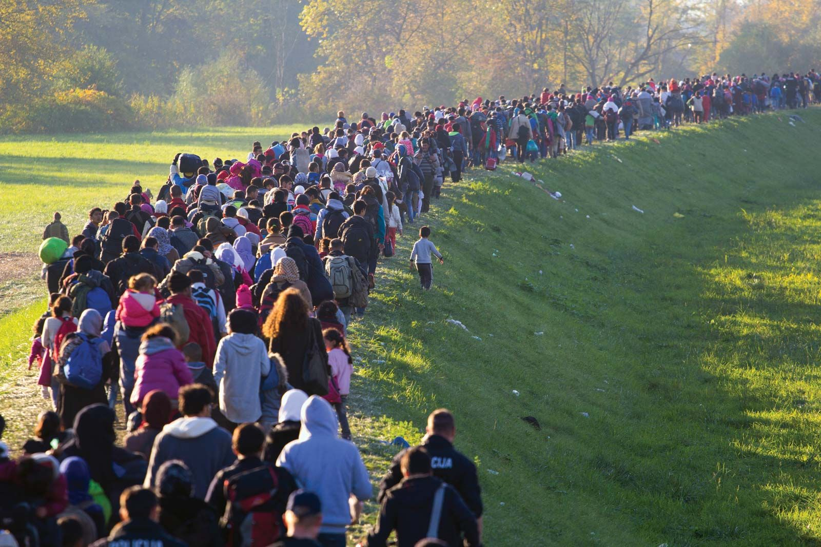
Collective models
Goal: generate/predict mobility flows between origins and destinations
Examples:
Migration/relocation flows

Slide 24
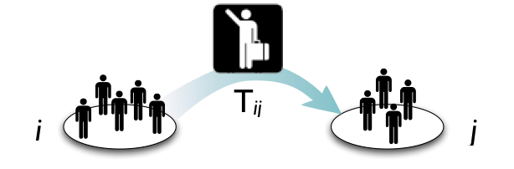
Spatial flows and OD matrices
Mathematically, spatial flows are represented as a Origin-Destination (OD) matrix, T:
🔵 Define locations discretizing space, using a tessellation (e.g., counties, municipalities)
🔵 Element T_{ij} is the number of trips from i to j per unit time.
New York City, NY
Boston, MA

Slide 25
Lab2: Human Mobility Measures.

Slide 26
Thank you

